Slide 1

Community Meeting #2
Downtown Parking Code Update Project
(and Middle Housing)
September 23, 2021 4:00 – 6:00 pm
City of Madras, Oregon
Notes:
Nick

Slide 2




Agenda
CITY / AGENCY PARTNERS
Introduction (10 min)
Background | Purpose (15 min)
  TGM Program + Smart Development
  Code Update Project
Parking (30 min)
  Project objectives
  Parking Policy and Data Memorandum
  Strategy Outline and Parking Plan Framework
Project Schedule
Interactive Conversation (30-45 min)
  Prompts/Questions
  Comments/Feedback
  Poster Stations
INFORMATION + INPUT!
CONSULTANT TEAM
Notes:
Nick

Slide 3
Team Members
Agency Partners
Nick Snead City of Madras Project Manager
Laura Buhl Dept. Land Conservation and Development Project Manager
Consultants
Jim Hencke David Evans and Associates, Inc. Project Manager
Rick Williams Rick Williams Consulting Parking
Marcy McInelly Urbsworks Housing
Gigi Cooper David Evans and Associates, Inc. Planner
Notes:
Nick

Slide 4

Transportation & Growth Management (TGM)
Oregon Department of Transportation (ODOT) and Department of Land Conservation and Development (DLCD)
MISSION
Link land use and transportation planning
Expand transportation choices
Create livable places where people can walk, bike, take transit, or drive where they want to go
https://www.oregon.gov/lcd/TGM/Documents/mission-goals-objectives.pdf
Notes:
Laura

Slide 5
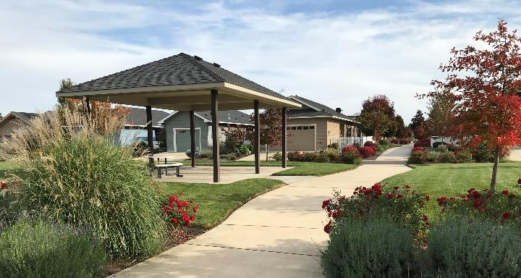
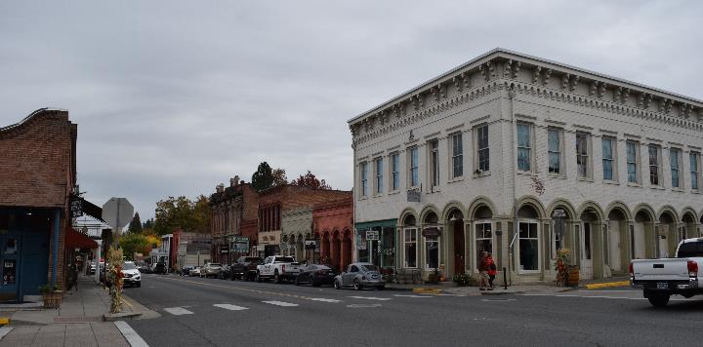
TGM Code Assistance
Remove barriers to ‘Smart Development’
  Efficient use of land
  Full utilization of urban services
  Mixed use
  Transportation options
  Detailed, human scaled design
Methods and Tools
  Code audits
  Complete overhaul / partial code update
  Model Development Code for Small Cities
Use a small town downtown image
Like Spray or Lakeview or Fossil?
Notes:
Laura

Slide 6



Project Overview
Downtown Parking
Measure use in downtown (occupancy/turnover)
Recommend programs/policies for parking management
Recommend Development Code amendments
Citywide Housing Code
Audit / Amend Development Code
Clarify standards for “Missing Middle” Housing Types
Evaluate Development of Cottage Housing Development Standards
Evaluate Permitting Multi-family in C-2, C-3, and Downtown
Review Street Standards to Lower Development Costs
Notes:
Lura to Jim

Slide 7
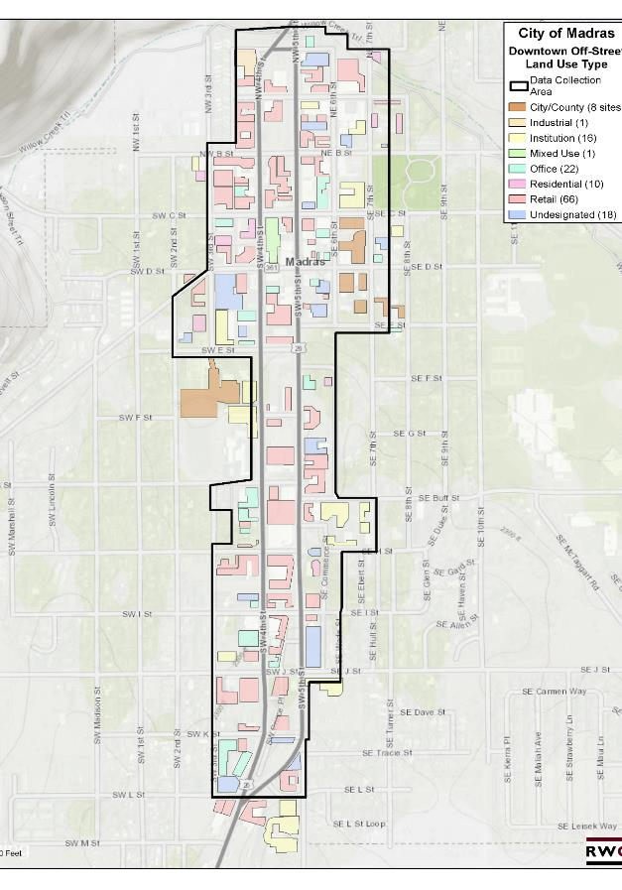
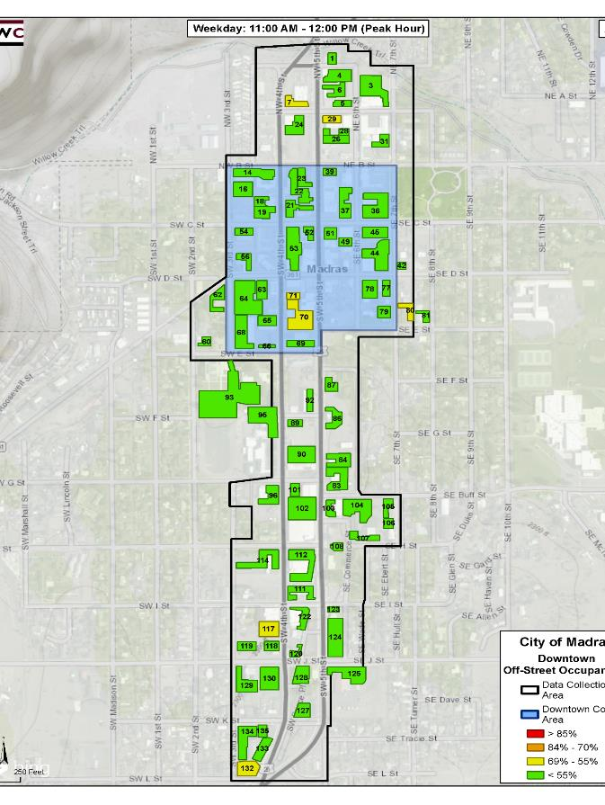
Base System
- 1,307 on-street
- 2,315 off-street
- 82 parking lots
Significant land area in surface parking
Low parking use in off-street supply
Notes:
Jim to Rick (images to Nick)

Slide 8
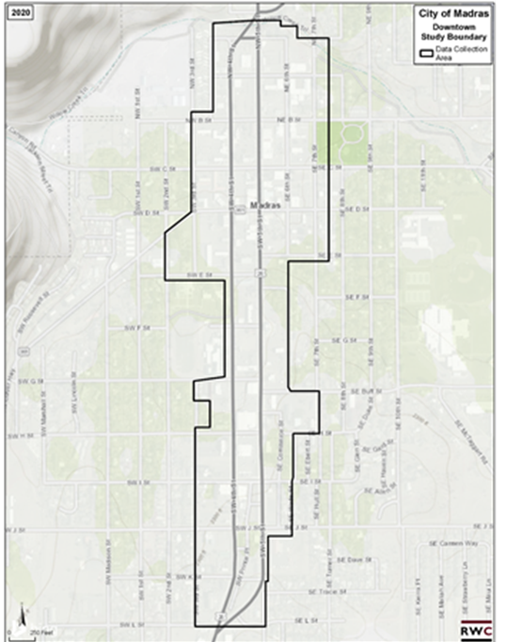
Findings - Parking Policy and Data Memorandum
Background and Purpose
Focus on Downtown (see map)
Evaluate code and parking policies for Downtown
Evaluate intent and purpose for parking management
Primary Sources
Madras Comprehensive Plan
Transportation Systems Plan
Urban Renewal Action Plan
Revitalization Toolkit
Local Input
Stakeholder interviews
  - Perceptions of Downtown parking, challenges, opportunities

Slide 9
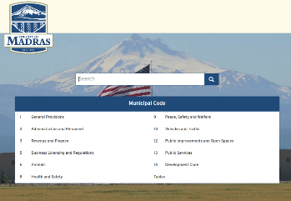
Findings - Parking Policy and Data Memorandum
What we learned
City Policy Documents (Comprehensive Plan, TSP, Urban Renewal Action Plan)
  Lack of formal parking policies for:
    State priorities/guidance for parking management intent & purpose
    Guide management of Downtown parking
    Inform decision-making for growth in Downtown
Municipal Code
Lacks policies to support stated regulations
Minimum parking requirements excessive; no link to parking demand
Revitalization Toolkit
Ideal framework for planning related to parking and urban form
Notes:
Trim words? “dare to have incomplete sentence”

Slide 10
Findings - Parking Policy and Data Memorandum
What we heard
5 stakeholder forums (13 participants)
Consensus Themes
Priority Parker: On-street priority access is for customers
Usability: Signage and wayfinding is confusing
Communications: Establish priorities, involve businesses and stakeholders
Shared Parking: Need data and strategy for setting up a program
Management: Goal oriented strategies – “incremental and incentive based”
Code: Support for more flexible off-street requirements
Identity: Preserve and enhance Madras’ “inviting and welcoming feel”

Slide 11

Findings - Parking Policy and Data Memorandum
Recommendations – Strategy Direction
Goals & Priorities: Develop Guiding Principles (priorities and outcomes)
Code (general): Implement “housekeeping” updates
Code (specific): Re-evaluate minimum parking requirements
Data: Inventory/occupancy study to inform new policies & strategies
Parking Plan: Be strategic and incremental, with near, mid, long-term actions

Slide 12

Findings - Parking Policy and Data Memorandum
Parking Management Plan Framework
Coordinate internal administration for parking Downtown
Develop Guiding Principles
Establish Stakeholder Parking Work Group
Initiate code changes to support management and growth
Better manage on-street parking
Improve look of, maximize opportunities in, off-street parking
Enhance awareness/information/communications
Provide, protect residential parking in adjacent neighborhoods
Strategically integrate with other modes (bike, transit, walking, rideshare)
Notes:
Define “improve” as part of presentation

Slide 13

Schedule
2020
2021
2022
1. Project Kick-Off
Community Tour / Documents / Planning Commission
2. Parking Data Collection
Inventory / Interviews / Analysis
3. Evaluate Existing Plans / Policies
Evaluation Memo / Community Meeting #1 (HOUSING)
4. Code Drafting
PROJECT ENDS – EARLY 2022
Community Meeting #2 (PARKING)
DRAFT Parking Plan (9/17), DRAFT Housing Amendments (Oct 4/Nov 15)
Code Committee Meetings (Parking 9/30, Housing Oct 25/28)
Planning Commission Meeting (Dec 1)
9/23
5. Adoption and Public Hearings
FINAL Parking Plan / Housing Amendments (Dec/Jan)
Planning Commission Public Work Session (Jan 19)
City Council Public Hearing (Feb 16)
Notes:
Rick to Jim. Nick to add PI commentary, COVID, efforts towards adoption

Slide 14
ZOOM VIRTUAL POLL
5 questions in pop up box on screen
Multiple choice or single choice
Results afterward

Slide 15
Question 1
What is your impression of parking in the downtown, particularly as it serves your specific interest in downtown? (pick one)
1. Working well, generally
2. Mixed results (some good, some not-so-good)
3. Not working well at all
Notes:
Jim send to Nick for poster

Slide 16
Question 2
Downtown parking is currently working well in serving: (pick all that apply)
1. my business
2. my customers
3. downtown visitors
4. employees

Slide 17
Question 3
Should there be "priority users" for on-street downtown parking? (pick top three)
1. customers and visitors
2. visitors
3. employees
4. residents
5. vendors
6. other

Slide 18
Question 4
Should there be "priority users" for off-street downtown parking? (pick top three)
1. customers and visitors
2. visitors
3. employees
4. residents
5. vendors
6. other

Slide 19
Question 5
Do you think implementing parking management in downtown Madras is a good idea? (pick one)
1. Yes
2. No
3. Depends

Slide 20
Discussion / Questions / Feedback

Slide 21
Thank You!
CONTACT: Nick Snead (nsnead@cityofmadras.us)
541-475-2344
Community Meeting #2
Paarking Code Update Project
September 23, 2021

