Slide 1
City of Madras System Development Charges
Jeff Hurd, Public Works Director
April 2016

Slide 2
Question?
#1 – Why are System Development Charges needed???
#2 – Are System Development Charges in Madras Fair and Reasonable???

Slide 3
Overview
What is a System Development Charge?
History of SDC’s in Oregon.
How do Jurisdictions Develop a SDC Fee (Methodology, Debt, Capital Improvement List)?
What are the Variables Associated With Assessing SDC’s (i.e. Credits, Communities, City Economic Development Goals)
Misconceptions
Resources (SDC Brochure, Self-Help Worksheet, Pre-Development Team Meetings, Post Trip Count)
Questions and Comments.

Slide 4
What is an SDC?
“System Development Charges (SDCs) are one-time charges on new development, and certain types of redevelopment, to help pay for existing and planned infrastructure to serve the development…. Under ORS 223.297 to 223.314, SDCs may be used for capital improvements for:”
Water supply, treatment and distribution
WW collection, transmission, treatment and disposal
Drainage and flood control
Transportation
Parks and Recreation. (State of Oregon Website)

Slide 6
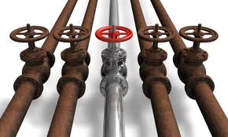
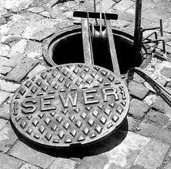
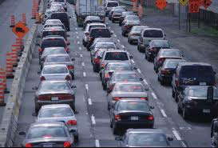
History of SDC’s (enacted in 1989)
Measures Affecting Funding Available for Infrastructure :
Federal Grants For Infrastructure Declining (1980’s)
Gas Tax Insufficient
Measure 5: (1990)
Cities are limited levying no more than $10.00 per $1,000 of market value per property.
Measure 50: (1997)
A cap on assessed value growth of 3% annually, except for new construction, subdivision, remodeling, rezoning, loss of special assessment or exemption;

Slide 7
The SDC Calculation

Slide 8
Madras SDC Fee Methodology
Transportation: Assess based on Peak Hour Trip generated utilizing the ITE Manual.
Parks: Assess per dwelling, apartment unit, or new business
Water: Based on water meter size 5/8” x ¾” = 1 Unit
WW: Based on water meter size 5/8” x ¾” = 1 Unit
Storm: Assess for every 3,000 square feet of impervious surface.

Slide 9
Variables with Assessing an SDC
Capital Improvement Plans
Credits
Previous Use vs. New Use
Special Commercial Corridors
Capital Improvement
Trip Rates – ITE vs. Jurisdictional Established

Slide 10
Misconception: “We can’t build because SDCs and permits are too high !!!”
2,000 SF Home in Madras = $298,000

Slide 11
Misconception: “We can’t build because SDCs and permits are too high !!!”
2,000 SF Home in Bend = $375,000

Slide 12
Misconception: “I pay my taxes, why do I need to pay SDCs??!!”
ORS 223.297 - 314, known as the SDC Act, provides “a uniform framework for the imposition of system development charges by governmental units” and establishes “that the charges may be used only for capital improvements.”
Transportation Revenues:
Franchise Fees
Gas Tax
Other Taxes (Liquor, Cigarette)
Park Revenues:
5% of Property Taxes to Parks. 95% of Property Taxes to PD
Water and Waste Water Revenue:
User Fees
Stormwater:
Non-Existent

Slide 13
Misconception: “I pay my taxes, why do I need to pay SDCs??!!”
Transportation Need.
Debt Service ($929,000); $5.6 million in deferred maintenance.
Need $600k per year to maintain hold the decline for 20 years.
$13.3 million to pave gravel roads to non-City standards.
$24.7 million to pave gravel roads to City standards.
Wastewater Need.
WW is for debt service ($10.49 million – 1990s - 2009)
$3,000,000 to repair.
$5,000,000 to replace.
$25,000,000 to expand.
Parks Need
Willow Creek Trail System
Existing Park Expansions
New Parks
Water CIP list
Waterline projects $2.1 million

Slide 14
Misconception: “SDC’s in Madras are higher than other jurisdictions in C.O.”!!!!
2,000 SF Home on a 7,500 SF Lot with a 5/8” x ¾” Water Meter, Sewer Service and 3,000 SF of Impervious Surface

Slide 15
Misconception: “SDC’s in Madras are higher than other jurisdictions in C.O.”!!!!
The City can’t waive SDCs due to annual debt service requirements.
2010
Reduced SDCs by 20%
No increases to SDCs for 3 years
Provided Deferred Payment Option
No SDCs for Temporary Uses (24 mo.)
Payment Plan for Changes in Use

Slide 16
Resources
Pre-development meetings and estimates
SDC Self-Help Worksheet
Payment plans for change of use
SDC deferral for new construction
Discount if paid at time of building permit

Slide 17
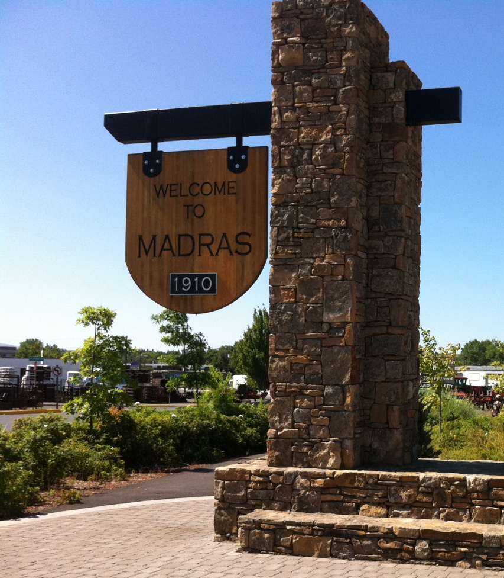
Questions?

